Slide 1
Student expectations for all-virtual learning

Slide 2
most expectations don’t change….
Sitting at a table or desk (not in bed)
Cameras on showing shoulders up and full face - unless request permission to turn camera off
use regular lighting (difficult to see in some weird lighting)
Be ready to participate in class when called on and be engaged verbally and in chat as expected
Dressed in uniform
Phones silenced and out of reach
have your parents use email to communicate with you during the school day
You must be on time for each class.
If you are late to class, the penalty is a detention, just like if we were in the building.

Slide 3
most expectations don’t change….And some reminders
In fact, we have reminded your teachers that they can and SHOULD issue you detentions for any of these behaviors.
This is part of the way we help you learn and grow. No matter where we are, we are committed to making sure you do that.

Slide 4
Some things that you will need to make sure you do
Check your email every day at least twice a day.
We KNOW you get a lot of email.
But that is not an excuse for not reading it. In fact, this is just a fact of being a student and eventually a professional.
The natural consequences will apply for anything you have not taken care of because you didn't check your email.

Slide 5
Some things that you will need to make sure you do, continued
Follow these important steps if you have a technology issue.
IMMEDIATELY email Mr. Wallace at russ.Wallace@ahsrockets.org and tell him what is happening with your tablet
Copy your teacher and counselor on that email to Mr. Wallace.
Log into your Microsoft account via another device if possible.
Watch regularly for a response from Mr. Wallace and follow the steps he gives you to solve the problem.
If Mr. Wallace indicates that you need to have work done on your tablet, you must come to AHS within ONE WEEK to resolve the issue and/or get a loaner tablet.
If you don’t follow these steps, you will be held accountable for academic penalties.

Slide 6
Some ways you can help yourself
Get up and move around in between classes.
Reach out to your teachers and meet with them if needed.
Use the Achievement Center during your study hall.
Use your planners and check LMS.
Let your counselor or dean know if you need help

Slide 7
LEAD & Learn Wednesdays
Remember these are days that are used for learning and are days you should be available from 9:00-3:00
Class and school-wide activities
Teacher meetings
Group work
Time to work on projects
Don’t put your friends and teachers in a position where they cannot count on your availability.
If you have an appointment, your parents need to notify the school as they would on any day

Slide 8
The elephant in the room
We know there is a lot of cheating going on and your teachers do, too.
We know many methods that are being used.
We are working vigilantly to address these.

Slide 9
Who are you cheating??
Your teachers
They are working tails off
They want to make sure you are learning,
Your classmates
They are angry with you and you are damaging relationships.
YOURSELF
Purpose of assessments is to make sure you know material!
If you don’t know the material, you ultimately hurt yourself.
Notes:
You talk how much you love them
They are working tails off
They want to make sure you are learning
The purpose of assessment
Cheating yourself

Slide 10
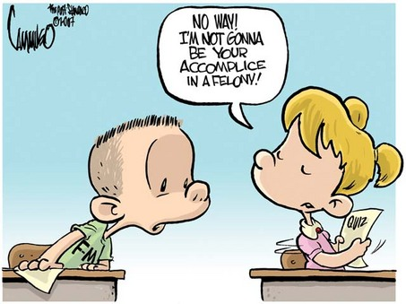
IF integrity really matters
It matters most when you are sure you won't be caught.
Don’t give in to moments of panic.
Plan ahead.
Be PROUD of the grades you earn.

